Slide 1


Pamela Y. Toussaint, MBA
Leadership & Human Skills Consultant
Ultimate Image Coach & Academy
Developing Leaders. Elevating Teams. Strengthening Results.
We Polish. You Shine.

Slide 2
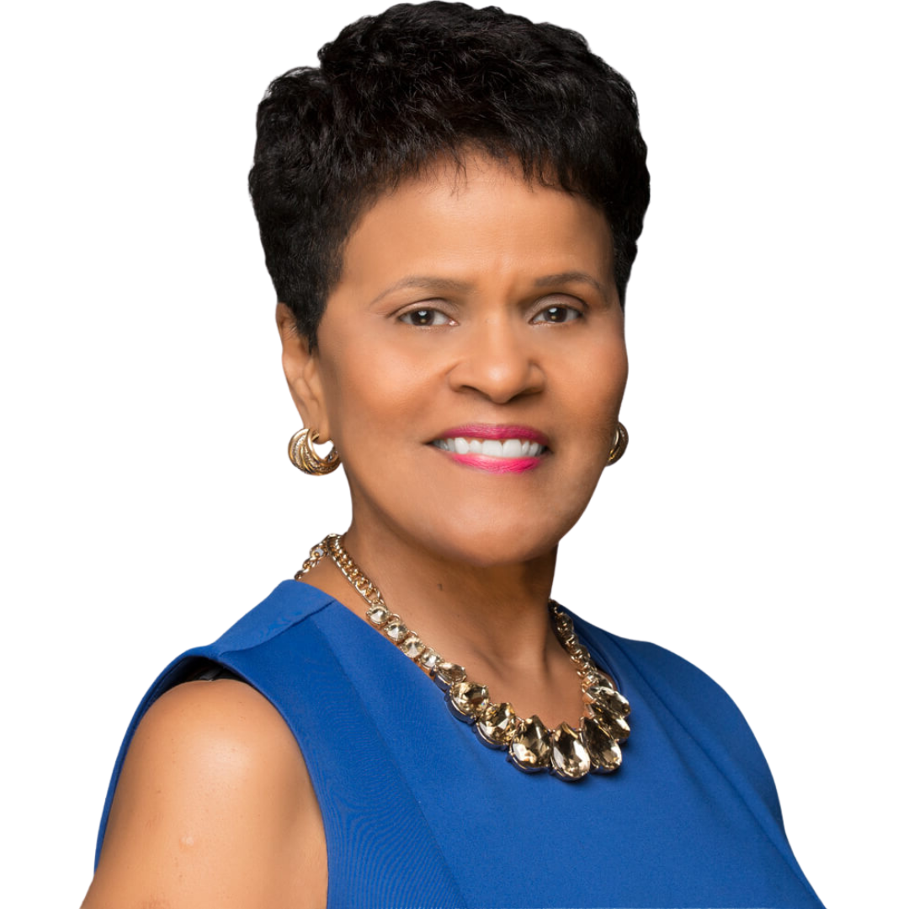
Who I Am
Pamela Y. Toussaint brings a rare dual perspective as both a corporate executive and a leadership development consultant.
20+ years executive & consulting experience
Former Fortune 100 HR & Operations Executive
Trusted advisor to municipalities, agencies & professional services firms
We Polish. You Shine.

Slide 3
Who I Serve
Municipalities & Government Agencies
Engineering, Architecture & Construction (AEC) Firms
Small Business Ecosystems
5
6
We Polish. You Shine.

Slide 4
Core Capabilities
Leadership & Human Skills
Development
Emotional Intelligence &
Communication
Everything DiSC®-Based
Team Development
RFP & Business Readiness
Training
Performance Management &
Feedback
We Polish. You Shine.

Slide 5
Signature Leadership Programs
Flagship programs delivered in-person, virtually, or hybrid
People Leader Excellence Programs
Leadership & Soft Skills Academies (in-person + eLearning)
RFP Mastery & Procurement Readiness Series
Customized Leadership Retreats & Workshops
6
We Polish. You Shine.
Customized | Scalable | Outcomes-Driven

Slide 6
Outcomes & Impact
Increased leadership consistency
Stronger manager confidence
Improved communication & accountability
Higher engagement and readiness
We Polish. You Shine.

Slide 7












Our Circle of Clients

Slide 8
Why Pamela / Differentiator
Executive-level perspective, not “off-the-shelf” training
Bridges strategy ↔ people ↔ execution
Speaks C-suite and frontline fluently
4
Known for trust, polish, and results
5
6
We Polish. You Shine.

Slide 9
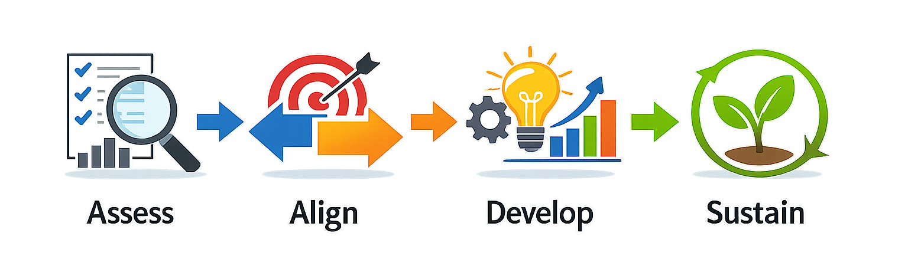
Engagement Model
4
5
6
We Polish. You Shine.

Slide 10
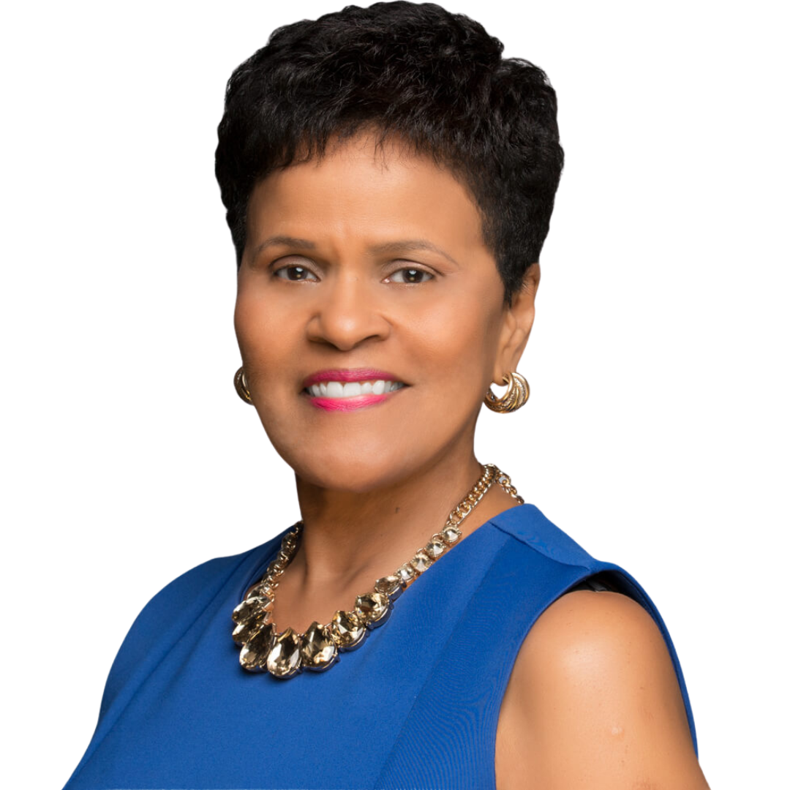
Contact
Pamela Y. Toussaint, MBA President, Ultimate Image Coach & Academy
Phone: 561-632-8679
Email: pamela@ultimateimagecoach.com
Website: ultimateimagecoach.com
LinkedIn: linkedin.com/in/pamelatoussaint
We Polish. You Shine.

