Slide 1


Sample Leadership & Personal Brand Workshop (Excerpt)
Presented to the Company Name
Presented by:
Pamela Y. Toussaint
www.ultimateimagecoach.com

Slide 2


Program Goals
Enhance professional image and personal brand
Develop a strategic mindset for career growth
Master key soft skills: Communication, Presence, and Influence
Align professional presence with Your Company Name values

Slide 3

Why Personal Branding
Matters at Work
1. Enhance the member experience through confident, polished presence.
2. Stand out internally for growth opportunities and leadership visibility.
3. Align your image with Your Company Name’ values of excellence, diversity, and belonging.

Slide 4


Slide 5



Your Personal Brand in Three Words
Identify: What three words describe how you want to be seen at Your Company Name?
Partner Talk: Share your three words with someone at your table.
Goal: Choose words that align with professionalism, service, and your strengths.

Slide 6





Define Your Brand
Self-Reflection Questions:
What are your core strengths?
What value do you bring to your team and members?
How do you want to be perceived by leadership and peers?

Slide 7


Create Your Personal Brand Statement
Use this template to craft your brand statement:
I am [Your Name], a [Role/Function] who [What You Do].
I help [Who You Help] by [Your Unique Value or Strength].
Pair up and practice saying your brand statement out loud!

Slide 8

Presence in Action:
Real Talk Scenarios
🎭 Scenario Role Play:
Greeting a member with confidence and warmth.
Sharing an idea with your manager.
Introducing yourself to a new colleague or guest.

Slide 9

Dress for Success
at Your Company Name
Key Highlights from Dress Code:
Uniforms and grooming guidelines matter
Professional appearance and grooming standards matter
Your presence represents Your Company Name Experience™

Slide 10



Brand Snapshots:
You at Your Best
Turn to a neighbor and describe a moment when you felt confident, successful, and seen.
What did you say or do that made an impact?
Those moments help define your personal brand.

Slide 11



WALK THE BRAND:
POISE, POSTURE & PRESENCE
Three volunteers:
Walk to the front of the room as if you're about to:
Greet a colleague/client
Interview for a promotion
Open an event as the host

Slide 12

Energy

Slide 13

Key Takeaways
✅ Your brand speaks before you do—own it with purpose.
✅ Strategic presence builds trust and visibility.
✅ Consistency, authenticity, and values alignment = growth.

Slide 14


Slide 15

BOOK GIVEAWAY
The Audacious Woman is a powerful call to action for every woman who’s tired of playing small and wants to blaze her own path to prosperity with courage and conviction. This transformational guide invites you to embrace audacity — not as arrogance, but as the fuel that turns risk into opportunity, fear into confidence, and vision into reality.

Slide 16
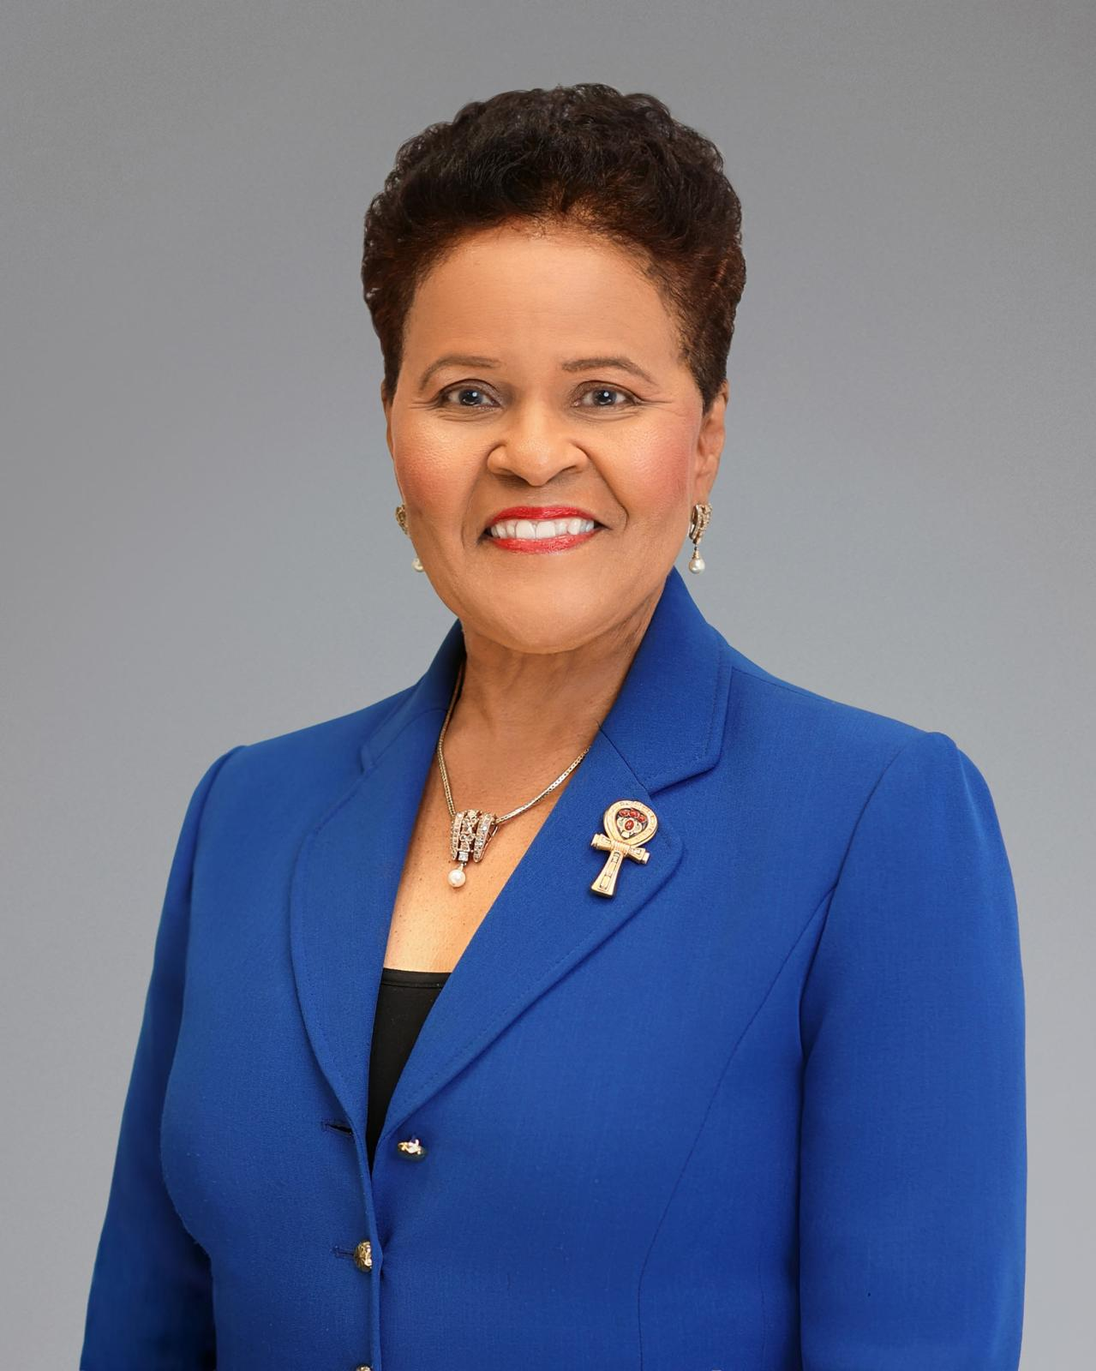
Let’s Stay Connected
Pamela Toussaint, MBA
President | Ultimate Image Coach & Academy
📧 pamela@ultimateimagecoach.com
🌐 www.ultimateimagecoach.com
Explore 100+ self-paced leadership & soft skills courses.

Slide 17

We Would Love Your Feedback
Thank you for being part of this empowering session!
Your feedback helps us grow and brings more value to future sessions. Share your thoughts and ideas using our quick feedback survey:
[Insert SurveyMonkey Link Here]
[Insert QR Code]

